Slide 1
Problem solving with similarity and Pythagoras’ theorem
Geometrical properties: similarity and Pythagoras’ theorem

Slide 2
How our teaching resources are designed for the classroom

Slide 3
I can use my knowledge of similarity and Pythagoras’ theorem to solve problems.

Slide 4
Pythagoras’ theorem states that the sum of the squares of the two shorter sides of a right-angled triangle is equal to the square of the hypotenuse.

Slide 5

Problem solving with similarity and Pythagoras’ theorem
Pythagoras’ theorem with coordinates
Pythagoras’ theorem with ratios

Slide 6
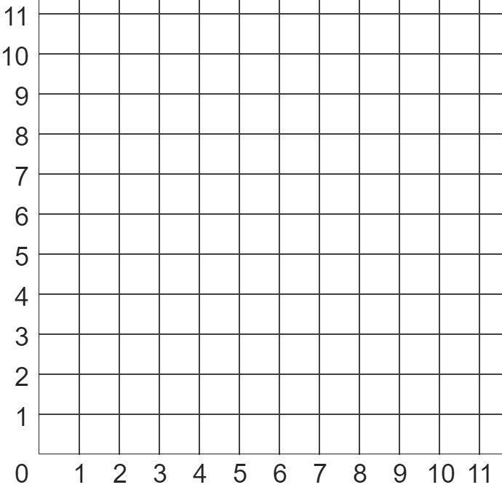


Pythagoras’ theorem with coordinates
Pythagoras’ theorem can be used to calculate the shortest distance between two points on a coordinate grid.
??? units
But how?
I thought Pythagoras’ theorem was all to do with right-angled triangles.
How can you make a right-angled triangle from only one straight line segment?
Andeep

Slide 7
Pythagoras’ theorem with coordinates
Pythagoras’ theorem can be used to calculate the shortest distance between two points on a coordinate grid.
A horizontal ray can be drawn from one of the points,
and a vertical ray can be drawn from the other point.
The point with which the two rays intersect is the third point of a right-angled triangle.

Slide 8
Pythagoras’ theorem with coordinates
In fact, the point where the two rays intersect is always the vertex of the right angle, itself.
Oh, that’s easy then.
I know which side is always the hypotenuse of that triangle!
Andeep

Slide 9
Pythagoras’ theorem with coordinates
In fact, the point where the two rays intersect is always the vertex of the right angle, itself.
??? units
The distance between the original two points is also always the length of the hypotenuse, since it’s opposite the right angle made from the two rays!
Andeep

Slide 10
Pythagoras’ theorem with coordinates
In fact, the point where the two rays intersect is always the vertex of the right angle, itself.
??? units
But I still don’t know the lengths of any of the sides of the triangle!
I can’t use Pythagoras’ theorem without two of them.
Andeep

Slide 11
Pythagoras’ theorem with coordinates
We can find the lengths of the two shorter sides by counting the number of squares up and across.
5.385 units
h units
We can now use Pythagoras’ theorem to find the shortest distance between the two original points:
2 units
h² = 2² + 5²
5 units
h² = 29
h² = 5.385
The shortest distance between these two points is 5.385 units in length.

Slide 12

Pythagoras’ theorem with coordinates
A right-angled triangle is made with a hypotenuse of AB.
What are the lengths (in units) of the horizontal base and vertical height of this triangle?
B
A
5
base: ________ units
a
3
height: ________ units
b

Slide 13
Pythagoras’ theorem with coordinates
What is the shortest distance between points A and B?
5.83 units
B
A

Slide 14
Pythagoras’ theorem with coordinates
Question: calculate the perimeter of this triangle.
In order to calculate its perimeter, you will need to calculate the length of each side.
For each unknown side length, we need to construct a right-angled triangle with that side as its hypotenuse.
x units
y units
10 units

Slide 15
Pythagoras’ theorem with coordinates
Question: calculate the perimeter of this triangle.
The hypotenuse of triangle A is:
triangle
B
x² = 5² + 7²
x² = 74
triangle A
8.60 units
x² = 8.60
5.83 units
The hypotenuse of triangle B is:
y² = 5² + 3²
y² = 34
10 units
y² = 5.83

Slide 16
Pythagoras’ theorem with coordinates
Question: calculate the perimeter of this triangle.
8.60 + 5.83 + 10
Therefore, the perimeter of this triangle is:
24.43 units
8.60 units
5.83 units
10 units

Slide 17

Pythagoras’ theorem with coordinates
Which of these is a suitable equation to calculate the hypotenuse of triangle A?
triangle A
a
a² = 7² + 9²
b
b² = 1² + 9²
c
c² = 6² + 7²
d
d² = 1² + 2²

Slide 18
Pythagoras’ theorem with coordinates
Calculate the length of the side labelled with an e, to 2 d.p.
7.07 units
triangle A
e units

Slide 19
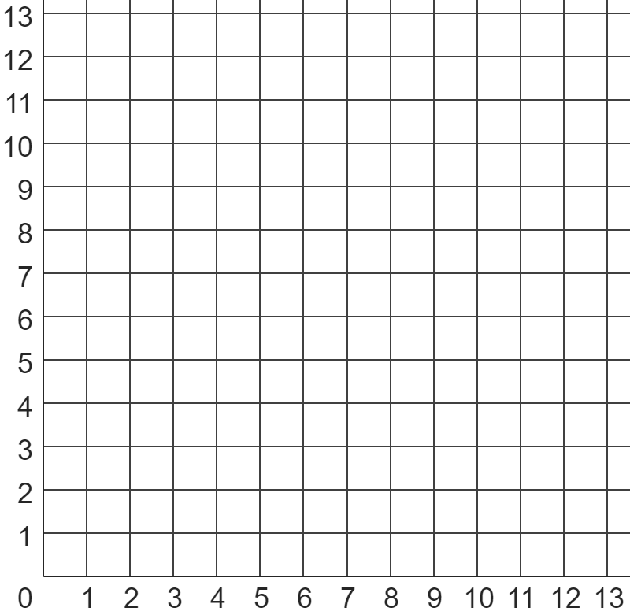
Pythagoras’ theorem with coordinates
B
1) Use Pythagoras’ theorem to find the shortest distance (to 1 d.p) between points:
A
a) A and B
b) A and C
c) B and D
d) C and D
e) B and E
C
D
E

Slide 20
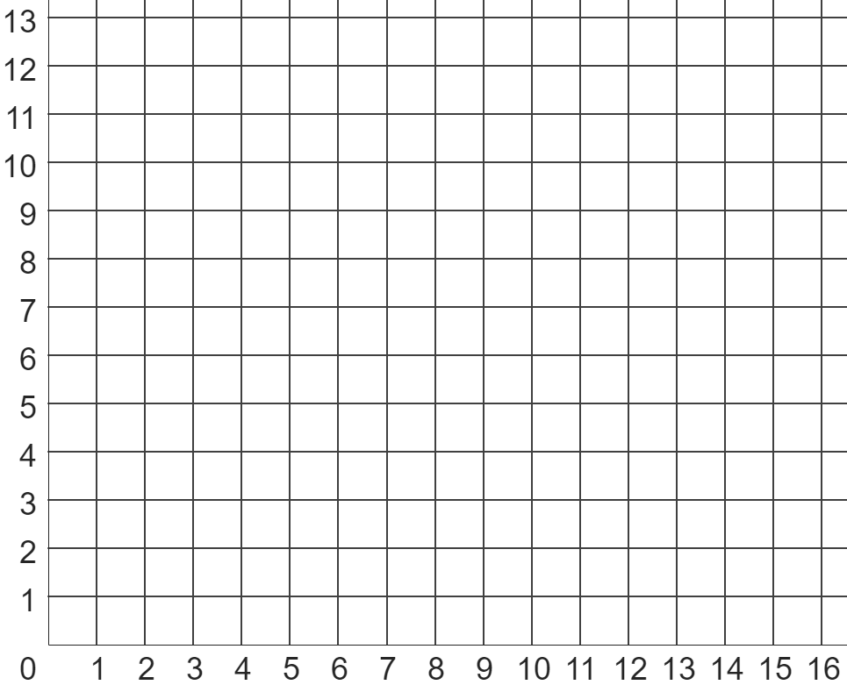
Pythagoras’ theorem with coordinates
scalene
triangle
2) Calculate the perimeter of each shape (to 2 d.p.).
square
3) Write down three coordinates whose vertices make a triangle with a perimeter of between 20 and 22 units in length.
Show this is correct using Pythagoras’ theorem.
isosceles
triangle

Slide 21
Pythagoras’ theorem with coordinates
B
1) Use Pythagoras’ theorem to find the shortest distance (to 1 d.p) between points:
A
a) A and B
b) A and C
c) B and D
d) C and D
e) B and E
6.7 units
4.5 units
8.1 units
8 units
12.2 units
C
D
E

Slide 22
Pythagoras’ theorem with coordinates
scalene
triangle
2) Calculate the perimeter of each shape (to 2 d.p.).
square
4 × 3.60555
14.42 units
square
isosceles triangle
2 × 7.071 + 10
24.14 units
isosceles
triangle
scalene triangle
5.83095 + 5 + 6.08276
16.91 units

Slide 23
Pythagoras’ theorem with coordinates
scalene
triangle
3) Write down three coordinates whose vertices make a triangle with a perimeter of between 20 and 22 units in length.
Show this is correct using Pythagoras’ theorem.
square
There are many possible solutions, such as a triangle with vertices (4, 6), (3, 12) and (10, 8)
isosceles
triangle

Slide 24
Problem solving with similarity and Pythagoras’ theorem
Pythagoras’ theorem with coordinates
Pythagoras’ theorem with ratios

Slide 25






Pythagoras’ theorem with ratios
You may see several similar shapes involving right-angled triangles on a daily basis without even realising it!
Most TV screens,
computer monitors,
and mobile phone screens
are similar in their shape.
This is so a movie can be played normally on one screen without it looking…
distorted or stretched on a different screen that is wider in proportion to its height.

Slide 26
Pythagoras’ theorem with ratios
We say that each of these widescreen screens are in the 16 : 9 aspect ratio.
16 units
Meaning for every 16 units across,
there are 9 units up.
9 units

Slide 27


Pythagoras’ theorem with ratios
The length of one “unit” is what changes between each screen.
16 units
9 units
That’s really cool…
But what does this have to do with Pythagoras’ theorem?
16 units
9 units
Andeep

Slide 28
Pythagoras’ theorem with ratios
When the size of a TV, monitor, or phone screen is described, only one length is given.
For example:
“this phone screen is 7 inches”
16 units
7 inches
9 units
This length describes the diagonal of the screen.
And so we can find the width and length of a screen by using Pythagoras’ theorem and ratios, since we know the screen will be in proportion to 16 units and 9 units.

Slide 29
Pythagoras’ theorem with ratios
To find the diagonal of a screen in units, we can use Pythagoras’ theorem:
16 units
x² = 16² + 9²
18.36 units
The screen is 18.36 units across its diagonal.
x units
x² = 337
9 units
x² = 18.36
We can then represent this information in a ratio table.
16 | 9 | 18.36
in units
width of screen
height of screen
diagonal of screen

Slide 30
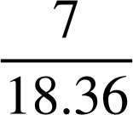
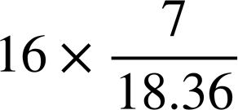
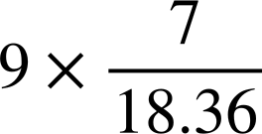
Pythagoras’ theorem with ratios
If we know the phone screen is 7 inches along its diagonal, then we can find its width and height in inches, too.
16 units
6.1 inches
18.36 units
7 inches
3.4 inches
9 units
We can then represent this information in a ratio table.
16 | 9 | 18.36
in units
×
÷
6.1
3.4
7
in inches
The phone screen is 6.1 inches wide and 3.4 inches tall.

Slide 31

Pythagoras’ theorem with ratios
Retro monitors had a width and height in the ratio 4 : 3
By using Pythagoras’ theorem, find out how many units long the diagonal of this screen is.
4 units
5 units
3 units
The diagonal is 5 units long.,

Slide 32
Pythagoras’ theorem with ratios
On the box of a retro monitor, it says
“18 inch screen”.
Where on this ratio table would the number 18 go?
4 units
5 units
3 units
width | height | diagonal
4 | 3 | 5
units
inches
a
b
c

Slide 33
Pythagoras’ theorem with ratios
On the box of a retro monitor, it says
“18 inch screen”.
What is this multiplier, k?
4 units
5 units
3 units
width | height | diagonal
4 | 3 | 5
 |  | 18
× k
÷
k = 3.6

Slide 34
Pythagoras’ theorem with ratios
On the box of a retro monitor, it says
“18 inch screen”.
What are the width and height of this monitor, in inches?
4 units
14.4 inches
5 units
18 inches
3 units
10.8 inches
width | height | diagonal
4 | 3 | 5
 |  | 18
× 3.6
÷
14.4 inches
10.8 inches
a
b

Slide 35
Pythagoras’ theorem with ratios
1) Each of these three widescreen TVs have width and height in the ratio 16 : 9.
8 inches
12 inches
a) Complete each sentence by choosing the appropriate word below.
screen A
Each of the TVs is ___________ to the others.
screen B
This is because their _________ and _________ are in ___________ to each other.
30 inches
The ___________ from screen A to B is 1.5.
proportion
scale factor
width
congruent
height
similar
screen C

Slide 36
Pythagoras’ theorem with ratios
1) Each of these three widescreen TVs have width and height in the ratio 16 : 9.
8 inches
12 inches
b) By using Pythagoras’ theorem, complete the ratio table for screen B (3 d.p.)
screen A
width | height | diagonal
16 | 9
 |  | 12
screen B
30 inches
c) Hence, calculate the width of screens A and C (2 d.p.)
screen C

Slide 37



Pythagoras’ theorem with ratios
2) Izzy wants to buy this ultra widescreen TV, which has a width and height in the ratio 22 : 9.
The TV has a 35 inch screen, and a stand that is 2 inches high.
Will the TV fit inside her TV cabinet?
TV cabinet
15 inches
36 inches
width | height | diagonal
ultra widescreen
22 : 9
aspect ratio

Slide 38
Pythagoras’ theorem with ratios
3) Jacob sees three TVs for sale, each having a 28 inch screen.
Jacob wants to buy the TV whose screen has the largest area.
Which TV should he buy?
retro TV (4 : 3 aspect ratio)
widescreen TV (16 : 9 aspect ratio)
ultra widescreen TV (22 : 9 aspect ratio)

Slide 39
Pythagoras’ theorem with ratios
1) Each of these three widescreen TVs have width and height in the ratio 16 : 9.
8 inches
12 inches
a) Complete each sentence by choosing the appropriate word below.
screen A
Each of the TVs is ___________ to the others.
screen B
similar
This is because their _________ and _________ are in ___________ to each other.
width
height
proportion
30 inches
The ___________ from screen A to B is 1.5.
scale factor
screen C

Slide 40
Pythagoras’ theorem with ratios
1) Each of these three widescreen TVs have width and height in the ratio 16 : 9.
8 inches
12 inches
b) By using Pythagoras’ theorem, complete the ratio table for screen B (3 d.p.)
screen A
width | height | diagonal
16 | 9 | 18.358
10.459 | 5.883 | 12
screen B
30 inches
c) Hence, calculate the width of screens A and C (2 d.p.)
screen A: 10.459 ÷ 1.5 = 6.97 inches
screen C: 10.459 × 2.5 = 26.15 inches
screen C

Slide 41
Pythagoras’ theorem with ratios
2) Izzy wants to buy this ultra widescreen TV, which has a width and height in the ratio 22 : 9.
The TV has a 35 inch screen, and a stand that is 2 inches high.
Will the TV fit inside her TV cabinet?
TV cabinet
15 inches
36 inches
No, the TV will not fit in the cabinet.
Whilst the screen is less than the width and height of the cabinet, the TV’s 2 inch stand makes the TV too tall.
width | height | diagonal
22 | 9 | 23.77
32.39 | 13.25 | 35

Slide 42
Pythagoras’ theorem with ratios
3) Jacob sees three TVs for sale, each having a 28 inch screen.
summary table of solutions
retro TV (4 : 3 aspect ratio)
widescreen TV (16 : 9 aspect ratio)
ultra widescreen TV (22 : 9 aspect ratio)
TV | width | height | area
retro | 22.4 | 16.8 | 376 inches²
widescreen | 24.4 | 13.7 | 335 inches²
ultra widescreen | 25.9 | 10.6 | 275 inches²
Even though all three TVs have a diagonal length of 28 inches, the retro TV has the screen with the largest area.

Slide 43
Problem solving with similarity and Pythagoras’ theorem
Whilst Pythagoras’ theorem can be helpful in finding the length of a side of a right-angled triangle when given the lengths of two other sides, it may not be necessary to use it, depending on whether the unknown value you are trying to find is an angle, an area, or a perimeter.
Pythagoras’ theorem can be used to find the length of a side when comparing two similar, right-angled triangles.
You can use Pythagoras’ theorem to find the shortest distance between two coordinates, or the perimeter of a shapes whose vertices lie on a coordinate grid.
Pythagoras’ theorem can be used alongside the aspect ratio of TVs in order to calculate the width and height of the TV screen, given its diagonal length.

Slide 44

© Oak National Academy 2024.
Produced in partnership with Mathematics in Education and Industry.
Licensed on the Open Government Licence v3.0, except where otherwise stated. See Oak terms and conditions.

